Slide 1
Data Intake Report Data Analysis
Prepared by:
Omer Salih Dawood Omer

Slide 2
The Client
XYZ is a private firm in US. Due to remarkable growth in the Cab Industry in last few years and multiple key players in the market, it is planning for an investment in Cab industry and as per their Go-to-Market(G2M) strategy they want to understand the market before taking final decision.

Slide 3
Business Problem
The analysis aimed to specify what is company has more margin of benefits, and what is preferred cab that users prefers.
There are fours tables:
Cab_Data.csv
Customer_ID.csv
Transaction_ID
City
To get more useful data first three tables merged into one file named as Merged_cab_data.csv

Slide 4
Analysis Steps
Classify data based one two or three steps (Cab Company).
Merge files.
Perform analysis through statistical analysis.
Check validity of generated plots.

Slide 5
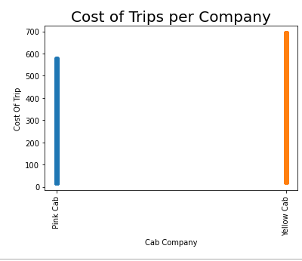
Cost of trips per Company
The Plot shows yellow cab company has more cost of trips compared with pink cab

